Slide 1
Challenge 1: I_Spy
-Dhiren Gupta
800902466

Slide 2
Idea
Divide the RGB plane
Change the RGB Image Gray Scale
Don’t compare whole object image. Only few pixels.
Restricted Search in big Image
Code Optimization.
Skip the object image Search

Slide 3
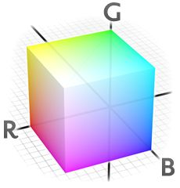
Divide the search in RGB Plane
First Search In the Red Plane. If objects pixel mismatched no need to keep running the for loop
If found continue in different plane.
Benefits:
Save numbers of loop execution.
In Matlab loop execution in more
costly than vector

Slide 4
Change the RGB Image Gray Scale
Rgb2gray Gives only intensities value.
My approach is to reduce the no of time loop runs to make search faster.
This approach gave significant improvement in search.

Slide 5
Compare Only Few Pixels
Our object image can be smaller as 27*21 or bigger as 151*149
So no need to compare all the pixels in parent image.
We can compare after eg. 20 pixels.
This number could vary.

Slide 6
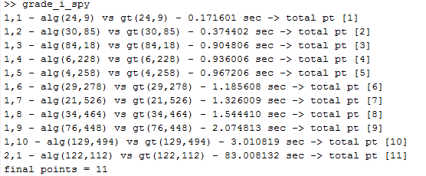
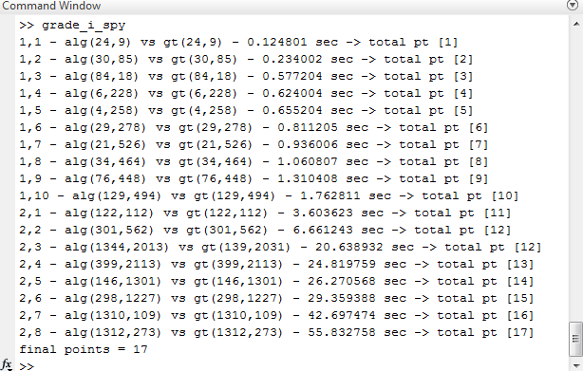
Comparison
Baseline
After 3 modification

Slide 7
Restrict Search
Main Problem was size of image.2
I found that objects are not starting from row 1 , column 1 so I started my search with increasing the index for row , column.
It’s like searching in shorter area

Slide 8
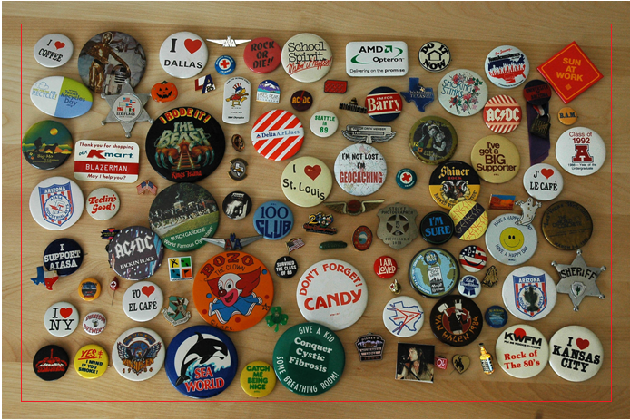
Search Area

Slide 9
Skip the object image search
This approach I had to choose because some images was taking too much time, so was not able to maximize points
So I calculated elapsed time for each image & if its more than 6-7 second I skip it.

Slide 10
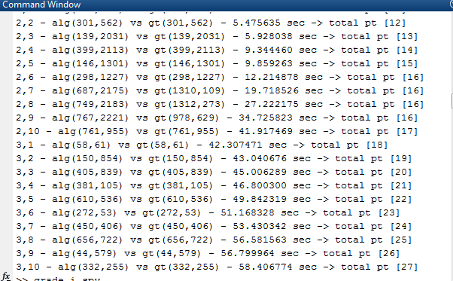
Comparision
First 3 approaches
Final result

Slide 11
Another Idea
I had another Idea for second Image
If we can remove the background and only compare the objects.
This can give boost to image search.

Slide 12
Questions?

Slide 13
Thank You

